Slide 1
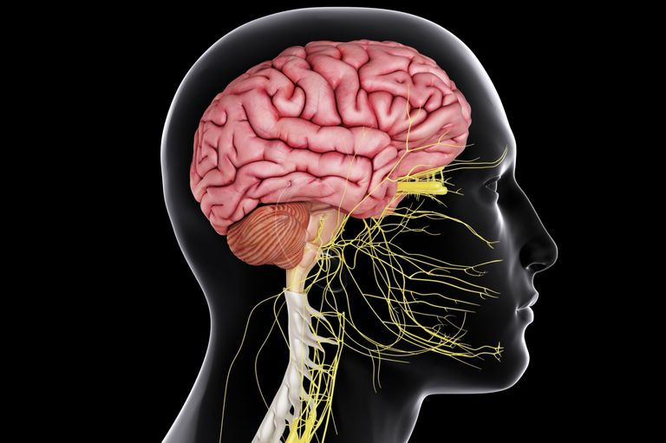
CNS Prioritized Molecules
Top Five Molecule Analysis For US Market

Slide 2
Executive Summary
US Top CNS Product Market 2020-21 in a Nutshell
BUPROPION HCL US MARKET
By Volume
17.4KT
By Value
2.15M
Growth rate
2015-2020
49%
GABAPENTIN US MARKET
By Volume
592KT
By Value
45.5 B
Growth rate
2015-2020
189%
SUMATRIPTAN US MARKET
By Volume
237MT
By Value
732 M
Growth rate
2015-2020
138%
RIVASTIGMINE US MARKET
By Volume
161MT
By Value
1.04 B
Growth rate
2015-2020
65%
PHENYTOIN US MARKET
By Volume
88.3 KT
By Value
6.8 B
Growth rate
2015-2020
198%

